Slide 1

DBMS
Ch:02
Entity Relationship Model
Mr. Ashraf Siddiqui
Vidya Vikas Education Trust’s
Universal College of Engineering, Vasai(E)

Slide 2
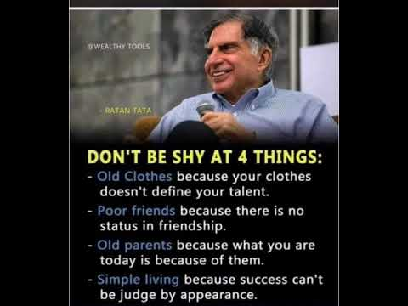

Slide 3
Steps to draw ER diagram
Identify Entities
Identify Attributes, Primary key
Identify relationship needed
Identify cardinality
Identify participation constraints

Slide 4
Example 01
Construct ER diagram for a car insurance company that has a set of customers each of whom owns one or more cars. Each car has associated with its zero to any number of recorded accidents.

Slide 5
Example 02
Construct ER diagram for a Hospital with a set of patients and a set of medical doctors associated with each patient a record of various test and examination conducted.

Slide 6
Example 03
Construct ER diagram for company which has several employees working on different types of projects. Several employees are working on one department. Every employee has manager. Several employees are supervised by one employee.

Slide 7
Example 04
Book club has members.
The book club sells book to its member.
The member places orders for books, which the book club fulfills.
Each order contains one or more than one book.
The books written by author.
The publisher publishes the book.
The author can write more than one book and a book can have more than one author.
A book is published by a publisher but publisher publishes many books.
A member can place more than one order.
The book club sells many books.

Slide 8
Example 5
Draw ER diagram for the education database that contains the information about an in house company education training scheme. The relevant relations are:
  Course(course_no,title)
  Offering(course_no, off_no,off_data,location)
  Teacher(course_no,off_no,emp_no)
  Enrollment(course_no,off_no,student_no,grade)
  Employee(emp_no,emp_name,job)
  Student(stud_no,stud_name,phone_no)

Slide 9
Example 6
Draw ER diagram for University database consisting four entities student, department, class and facility.
  Student has unique id, student can enroll for multiple classes.
  Faculty must belong to department and faculty can teach multiple classes.
  Each class is taught by only faculty.
  Every student will get grade for the class he/she enrolled.

Slide 10
Draw ER diagram for Airline Reservation System.
Draw ER diagram for Hotel Management system.
Draw ER diagram for Library Management system.
Draw ER diagram for Banking System.

Slide 11
Entities: Book, Member,Supplier, publisher, Librarian
Entities:
Relationship:

Slide 12
Thank you !

